Slide 1
ECTE 250
DELIVERABLE 3
Design Simulation
Group D:
Hani Jaaskelainen (7420833)
Vindhya Suvarna (7329696)
Mohammed Owais Gaonkar (7419296)
Mohamed Atef Ali (7399194)
Sneh Divyesh Parekh (7789713)

Slide 2

INTRODUCTION
Fall detection system
• According to WHO, falls are the 2nd leading cause of accidental deaths worldwide and the cause of 684,000 deaths of people globally.
•Most of them are adults older than the age of 60.
• To help tackle this issue, we suggest an Arduino-based fall detection system.

Slide 3
Overall Project description
Accelerometer monitors user motion to detect a fall (downward acceleration)
If a fall is detected, the system will ask the user if the measurement is a false alarm.
If false alarm is not pressed after 5 sec, system sends an SMS to emergency until contact response is received

Slide 4
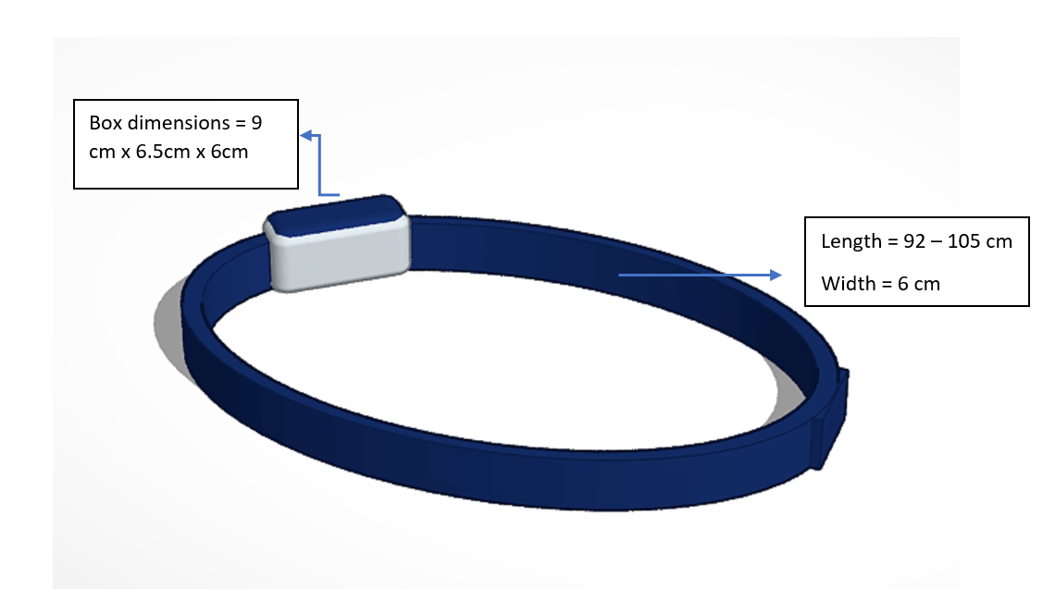
3d model

Slide 5
design

Slide 6
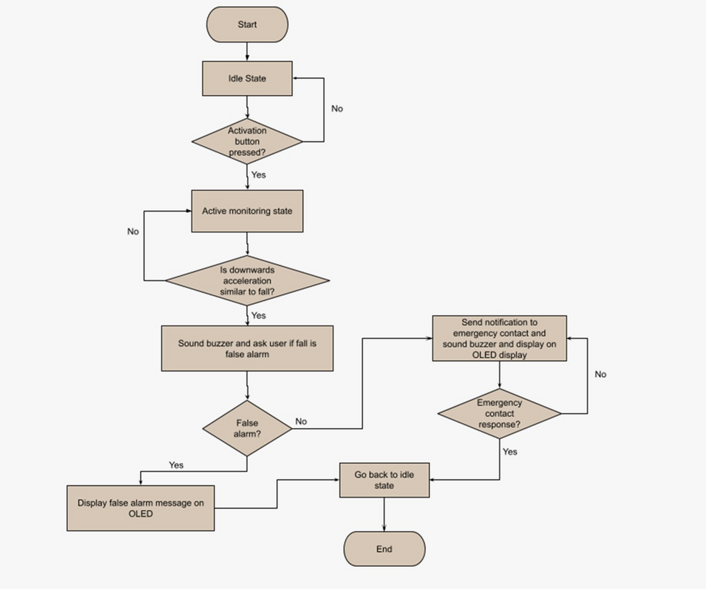
FLOWCHART

Slide 7
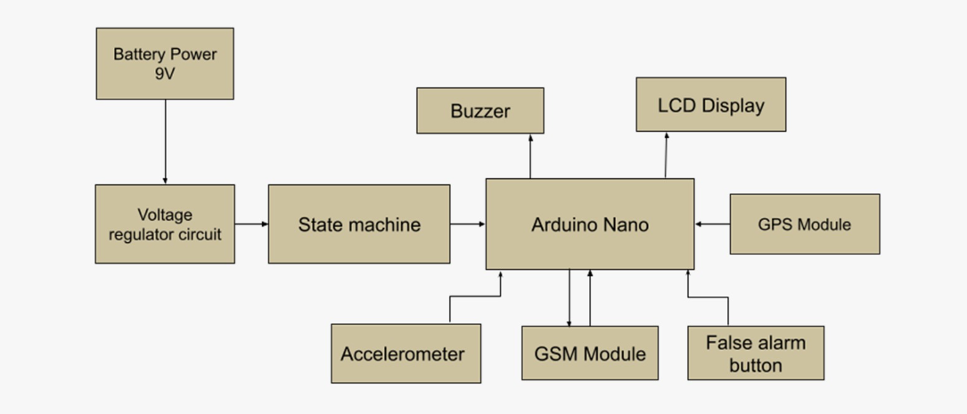
Block Diagram

Slide 8
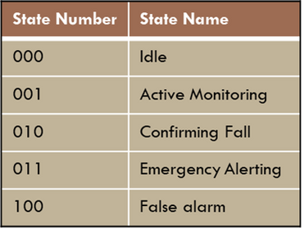
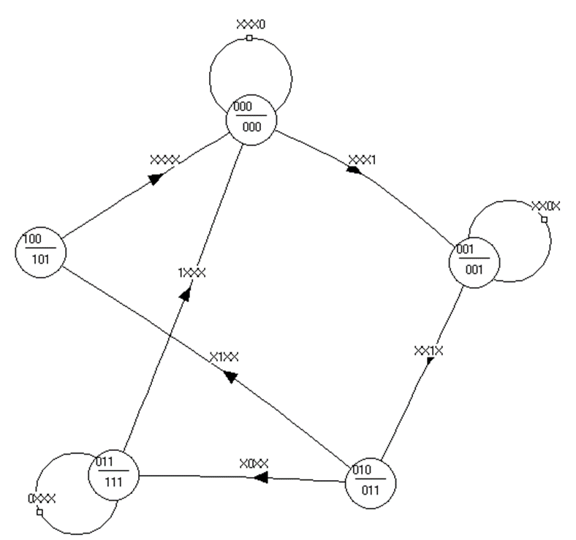
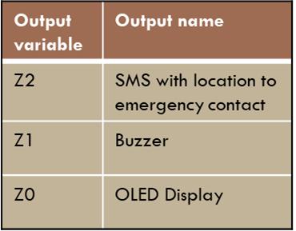
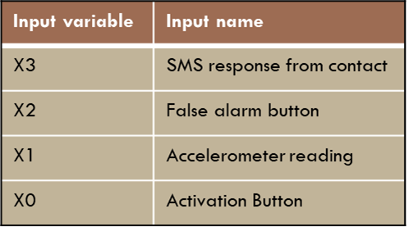
State Diagram

Slide 9
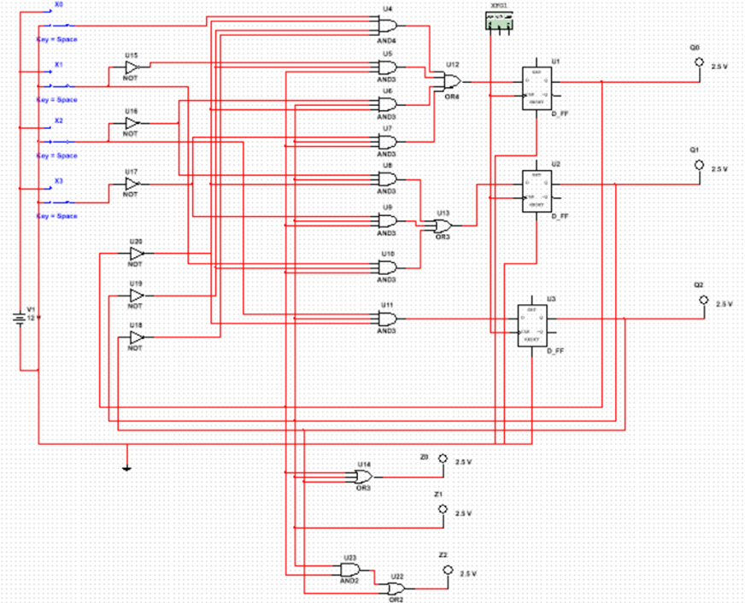
State machine

Slide 10
budget

Slide 11
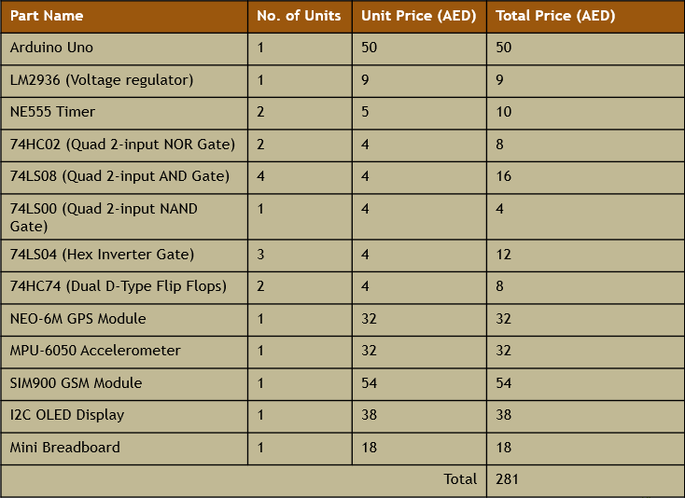
protoyping parts list

Slide 12
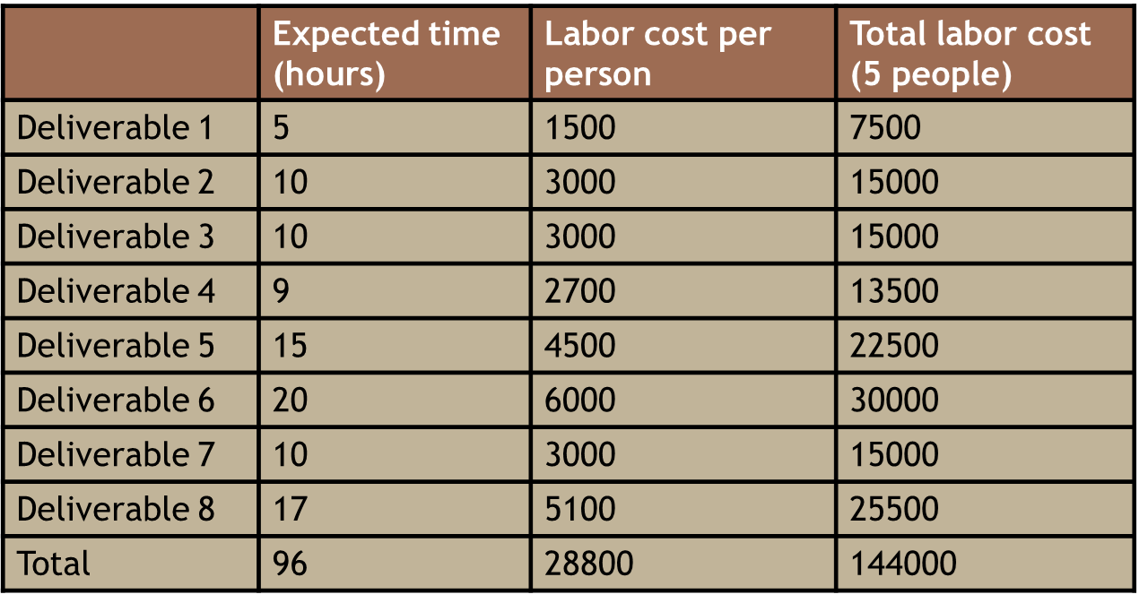
labor cost estimation

Slide 13
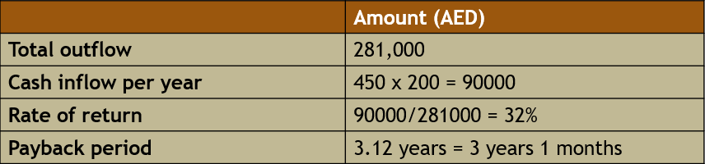
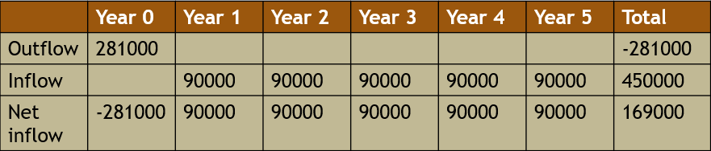

rate of return and net present value

Slide 14
MARKETING

Slide 15


Elder care facilities
Families of the elderly who want to ensure their safety and wellbeing
Home health care providers
Target customers
Patients recovering from falls or similar injuries
Senior living communities and retirement homes

Slide 16
Strategies to boost sales
Do a demonstration of the product to show how it works and allow potential customers to try it.
Utilize an eye-catching booth design and a catchy brand name and slogan to attract potential customers.
Provide leaflets and brochures that potential customers could take home and read more about the product
Set up the booth alongside companies operating in the same field as the field that our product is based in (healthcare-related products)

Slide 17

Any Questions?

